Slide 1
We are revising atomic structure and radiation
TRACK WITH ME
READ WITH ME
Students will be able to:
Demonstrate their understanding of previous topics
Name the different types of nuclear radiation
State the properties of each type of nuclear radiation

Slide 2
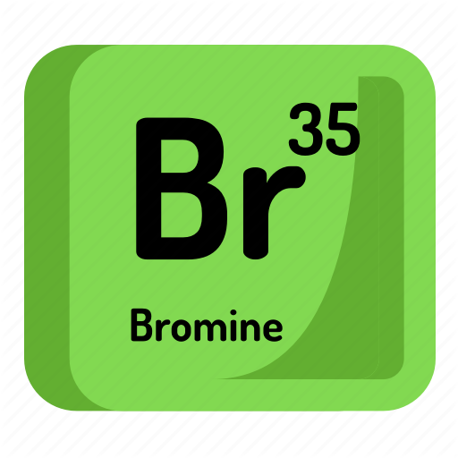
Repeat the opposite word/phrase.
ELEMENT
A SUBSTANCE THAT CONTAINS ONLY ONE TYPE OF ATOM

Slide 3
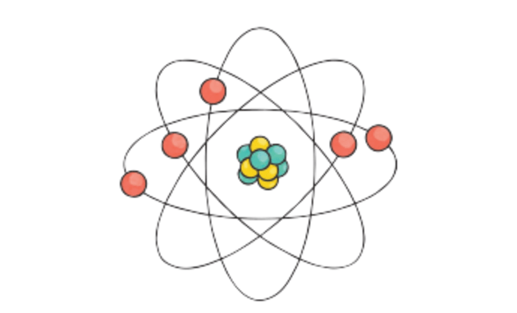
Repeat the opposite word/phrase.
ATOM
THE SMALLEST PARTICLE OF A CHEMICAL ELEMENT THAT CAN EXIST.

Slide 4
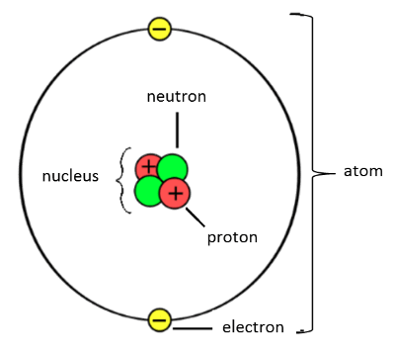
The structure of an atom
An atom is made up of protons, neutrons and electrons.
Protons and neutrons make up the nucleus which is at the centre of the atom.
Electrons are found in shells (or orbitals)around the outside of the nucleus.

Slide 5
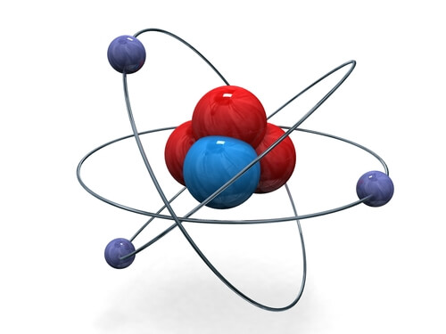
The structure of an atom
Atoms are made up of three subatomic particles: protons, neutrons and electrons.
The nucleus (centre) of an atom is made up of protons and neutrons.
The electrons orbit around the outside of the nucleus in shells.

Slide 6
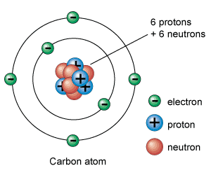
Charges!
A proton has a positive charge
A neutron has no charge
An electron has a negative charge

Slide 7
Charges!
A neutron has no charge
An electron has a negative charge
A proton has a positive charge

Slide 8


Types of Radiation
Alpha Particles: Identical to a helium nuclei.
4
2
He
Beta Particles:
Electrons emitted as radiation.
0
-1
e
γ
γ
Gamma Rays:
Emitted as a wave, not a particle.
0 0

Slide 9
Types of Radiation
4
2
He
Alpha
γ
0 0
Gamma
0
-1
e
Beta

Slide 10
Strength of Radiation
Alpha Radiation
Beta Radiation
Gamma Radiation
Sheet of Paper
Sheet of Aluminum
Thick Concrete Wall

Slide 11
Strength of Radiation
Gamma - Can only be stopped by lead or thick concrete
Beta - Can travel through paper but is stopped by aluminium
Alpha - Stopped by thin paper or a few centimetres of air

Slide 12
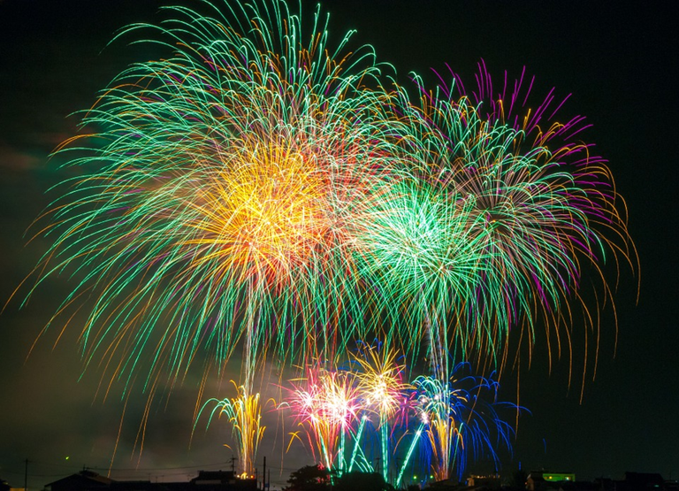
Signs of a chemical reaction
What are the signs of a chemical reaction?
Colour change
Gas produced (bubbles form)
Temperature change
Smell produced
Solid formed

Slide 13
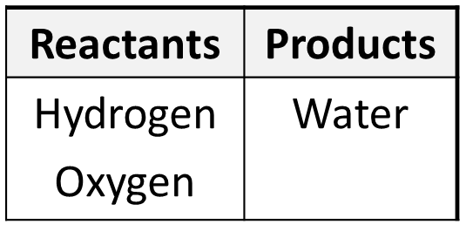
Reactants and Products
In a chemical reaction we start with one set of chemicals called the reactants.
A reaction happens and we end up with another set, called the products.
Example: when hydrogen and oxygen are reacted together they form water

Slide 14
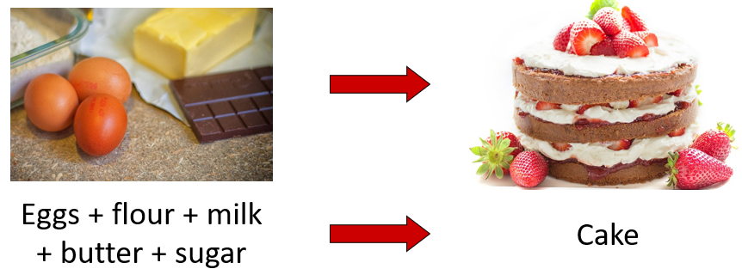
Word Equations
To show what is happening during a chemical reaction we can write a word equation
Reactants go on the left side, products on the right.

Slide 15
Word Equations
To show what is happening during a chemical reaction we can write a word equation
Reactants go on the left side of the equation
Products go on the right side of the equation

Slide 16
Word Equations
We use an arrow not an equals sign (=).
The arrow means “reacts to form”

Slide 17
Word Equations
In word equations we don’t use an equals sign (=).
We use an arrow that means:
“reacts to form”

Slide 18
Reactants and Products practice
When magnesium reacts with hydrochloric acid, magnesium chloride and hydrogen gas will be produced as per the word equation below.
magnesium + hydrochloric acid → magnesium chloride + hydrogen gas
a. What are the reactants?
magnesium and hydrochloric acid
b. What are the products?
magnesium chloride and hydrogen gas

Slide 19
Reactants and Products
In a car, when the engine is started enough energy is produced to combine nitrogen from the air with oxygen to form nitrogen dioxide.
a. What are the reactants?
nitrogen and oxygen
b. What the products?
nitrogen dioxide
c. What is the word equation?
nitrogen + oxygen → nitrogen dioxide

Slide 20
We are learning about atomic structure
TRACK WITH ME
READ WITH ME
Students will be able to:
Draw and label the structure of an atom
Determine the number of protons, neutrons and electrons in an element
Classify substances as elements, compounds, and mixtures.

